Slide 1
Precipitation Analysis
15 November, 2022
Notes:
National Aeronautics and Space Administration

Slide 2
Objectives
By the end of this exercise, you will be able to subset, analyze, and download precipitation data over the Parana region in southern Brazil. This exercise will use the Giovanni web tool and analyze rainfall statistics over the Sao Francisco Verdadeiro (SFV) watershed using QGIS.
Requirements
QGIS installed on your computer
https://arset.gsfc.nasa.gov/sites/default/files/water/drought/Introduction%20to%20QGIS.pdf
A shapefile for the Sao Francisco Verdadeiro (SFV) watershed saved on your computer
http://arset.gsfc.nasa.gov/

Slide 3
Outline
Part 1: Subset Data and Make Monthly Precipitation Time Series
Part 2: Make and Download Monthly Precipitation Maps
Part 3: Precipitation Analysis in QGIS
Convert NetCDF IMERG data into GeoTIFF
Interpolate and Clip Precipitation Data to SFV Watershed
Part 4: Analyze Precipitation Over SFV Watershed
Examine Histograms for Rainfall During December 2015 and 2016
Examine Mean and Standard Deviation of Rain Data Over SFV Watershed
Examine Inter-Annual Difference in Precipitation

Slide 4
Subset Data and Make Monthly Precipitation Time Series

Slide 5
Subset Data and Make Monthly Precipitation Time Series
Go to Giovanni: http://giovanni.gsfc.nasa.gov/giovanni
On the Giovanni page you will see the following options:
Select Plot: allows selection of analysis options
Select Data Range: allows selection of a time period
Select Region (Bounding Box or Shapefile): allows selection of a geographic region by latitude-longitude, map, or shapefile
Keyword: allows search of data parameters by keyword
Plot Data: (located on the bottom right of the page) begins the action to make a desired plot

Slide 6
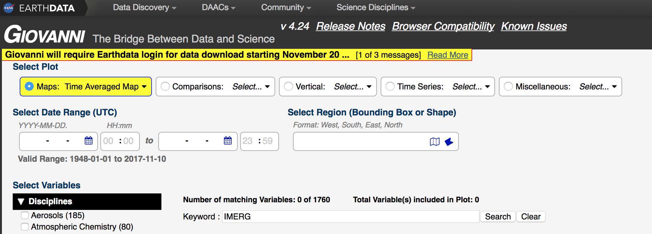
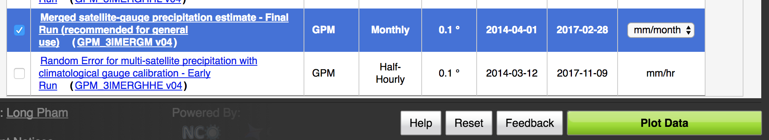
Subset Data and Make Monthly Precipitation Time Series
Enter the following options:
Next to Keyword
Enter IMERG. Click Search
Select Merged satellite-gauge precipitation estimate – Final Run (recommended for general use) (GPM_3IMERGM v04)
Set units to be mm/month

Slide 7
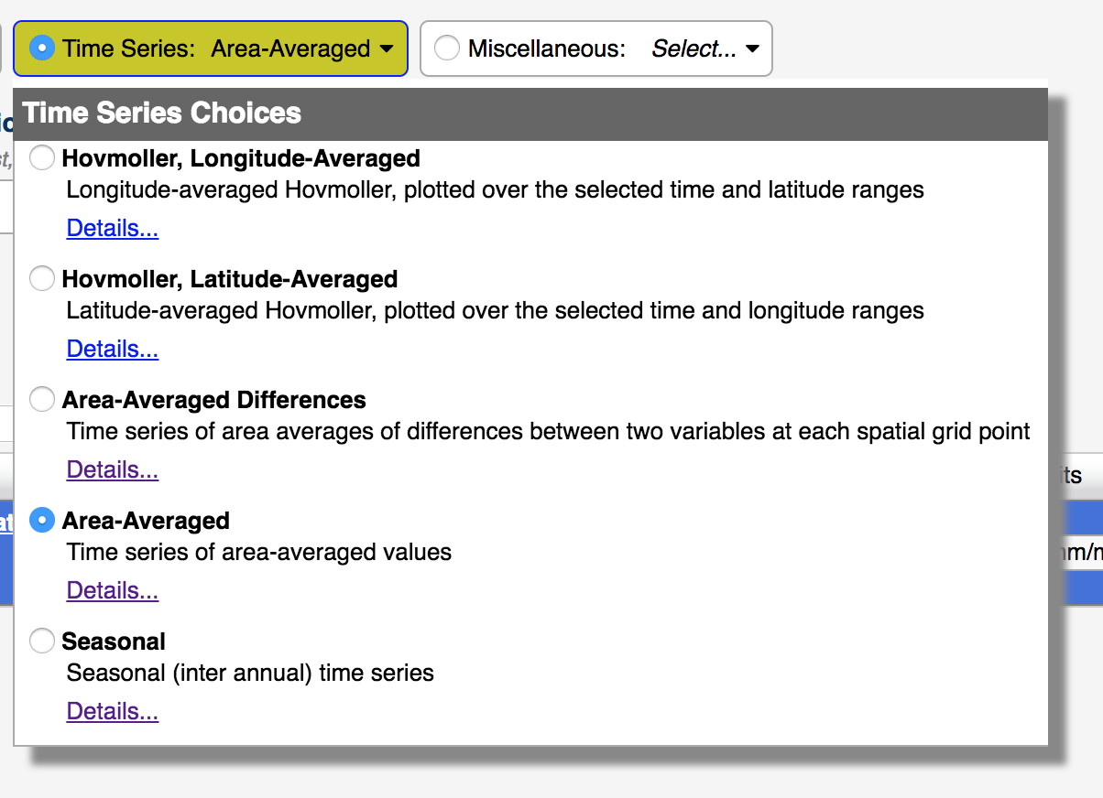
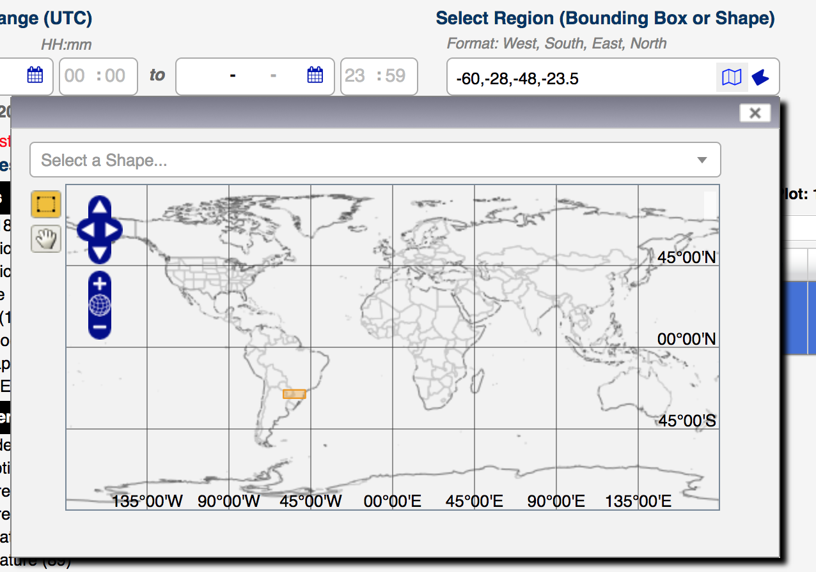
Subset Data and Make Monthly Precipitation Time Series
Under Select Plot
The default selection is Maps: Time Averaged Map. Select Time Series, and then select Area Averaged from the drop-down menu
Under Select Region (Bounding Box or Shape)
Enter the longitude-latitude around Parana: -60.0, -28.0, -48.0, -23.5
Note: west longitudes and south latitudes are negative, whereas east longitudes and north latitudes are positive
Click on the map icon to see the region

Slide 8
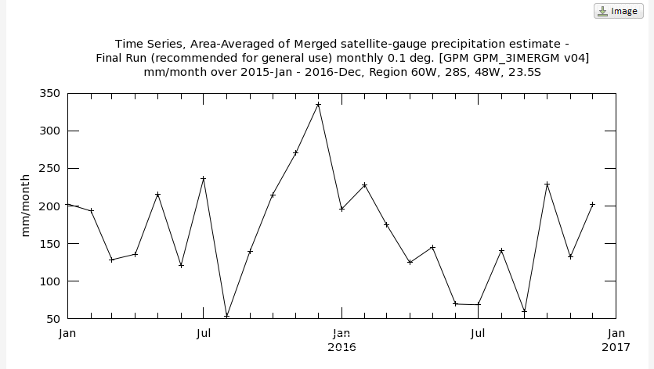
Subset Data and Make Monthly Precipitation Time Series
Under Select Date Range (UTC)
In the YYY-MM windows, enter 2015 - 01 for start and 2016 - 12 for the end date
Click on Plot Data (on the bottom right of the screen)
You will get the following time series plot

Slide 9
Discussion Questions
Which month/year had the maximum rainfall over Parana? Note the magnitude of the rainfall (with units) for this month.
Is the month of maximum rainfall the same in both 2015 and 2016? How much does the maximum rain magnitude differ from 2015 to 2016?

Slide 10
Make and Download Monthly Precipitation Maps

Slide 11
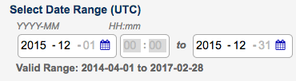
Make and Download Monthly Precipitation Maps
Click on Back to Data Selection on the lower right-hand side of the page
Enter the following options:
Under Select Plot, change to Maps: Monthly and Seasonal
Under Select Seasonal Dates, enter December and 2015 to 2015 (just the one month)
Click on Plot Data (on the bottom right)
You will get a map of monthly precipitation
Click on the Downloads link on the left, and you will see multiple file options. Choose the NetCDF file by clicking on the link to save the file to your computer.
Suggestion: Create a folder named ‘Parana-Data’ and save the December 2015 monthly files in the folder

Slide 12
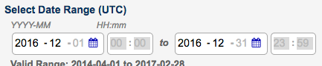
Make and Download Monthly Precipitation Maps
At the bottom right of the screen, click on Back to Data Selection
Repeat Select Data Range for December 2016
Click on the Downloads link on the left, click on the NetCDF file to save it on your computer in the same folder as the December 2015:
Suggestion: Rename the NetCDF file to avoid long Giovanni file name. For example: IMERG_Rain-Dec2015.nc & IMERG_Rain-2016.nc

Slide 13
Precipitation Analysis in QGIS

Slide 14
Precipitation Analysis in QGIS
Note: For the precipitation data you will need the latest version of QGIS (Preferably 2.18) to work with the NetCDF files. It is always a good idea to save your QGIS project often so that your work is not lost.
Open QGIS and start a new project
On the top menu bar, click on Web to check if you have OpenLayers Plugin
If you do not have the OpenLayers Plugin
Select Plugins from the top menu, and choose Manage and Install Plugins
You will get a window with options for Plugins
Enter OpenLayers in the search window
Clicking on the OpenLayers Plugin and press Install in the bottom right

Slide 15
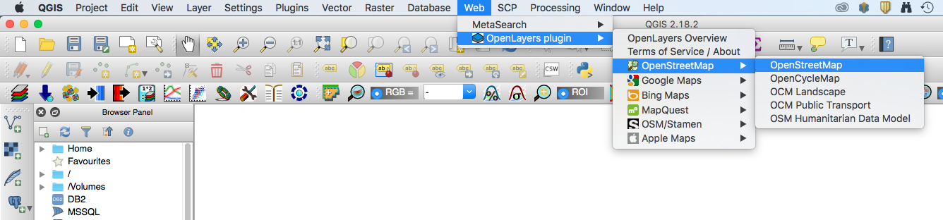
Precipitation Analysis in QGIS
From the top menu bar, click on Web, select Open Layer Plugin and select a background map
This exercise uses the background map OpenStreetMap

Slide 16
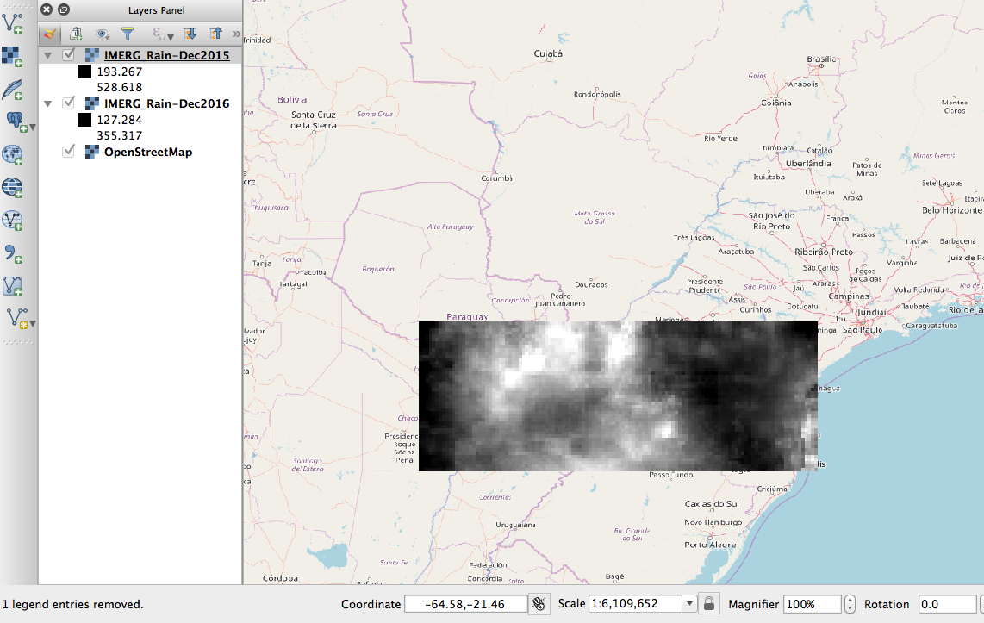
Convert NetCDF IMERG Data to GeoTiff
In your QGIS map, click on the Add Raster function on the left
Navigate to your saved IMERG Monthly Precipitation Files and click on Open to add the monthly data files for December 2015 and December 2016. You can do this all at once by highlighting both files.
A Coordinate Reference System Selector box may pop up. Select WGS84, EPSG 4326
From the top Menu Bar, you can zoom in and out on the layer
These NetCDF images have to be converted to GeoTIFF images for you to perform raster calculations on the data.

Slide 17
Convert NetCDF IMERG Data to GeoTiff
Right-Click (or Control-Click on Mac) on the raster layer IMERG_Rain-Dec2015
From the drop-down menu select Save As – this will open a window
Note that Format in the window is Gtiff
Make sure the Add save file to map option is checked.
Click on Browse and enter the folder name where all the data are and enter a file name (Suggestion: IMERG_Rain-Dec2015) and click on Save
You will see the GeoTiff layer displayed on the map and the file will be saved to the data folder
Repeat steps 3-4 to save the 2016 rain layer as a GeoTIFF
Now you can remove the NetCDF raster layers by right-clicking on each layer and choosing Remove

Slide 18
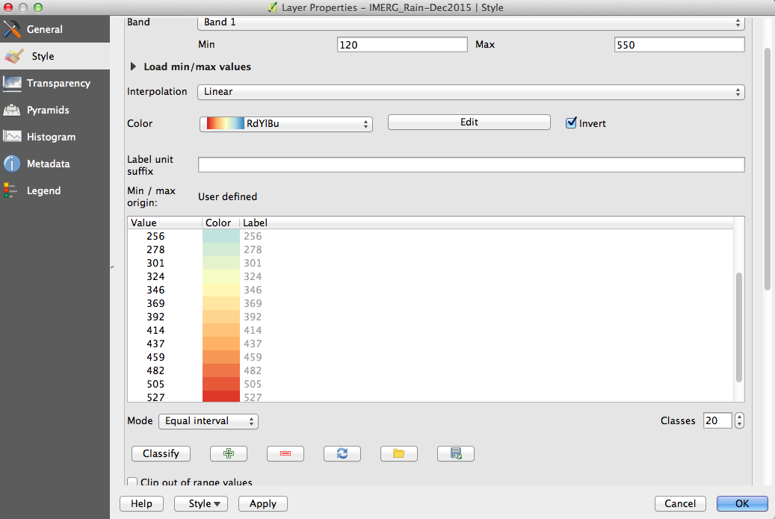
Convert NetCDF IMERG Data to GeoTiff
Right click on the layer file for December 2015 and go to Properties > Style
Select the Render Type as Singleband Pseudocolor
Next to Color, make sure the Red-Yellow-Blue (RdYlBu) color palette is selected
Select Invert so that low rain values are shown in blue and high in red
Select Min value to 120 mm/month and Max value to 550 mm/month
Below the color display, change the Mode to Equal Interval and Classes to 20. Click Classify. Click Apply

Slide 19
Convert NetCDF IMERG Data to GeoTiff
Without closing the Properties window, move it over to take a look at the image. It should have the color designations you just selected.
Click OK to close the Change Color box
Change the December 2016 layer map to have the same color scheme by following step 7
Make the precipitation layers for 2015 and 2016 semi-transparent to see the map underneath
Right click on the layer file and go to Properties > Transparency
Set the Transparency level to 50%
Under No data value set Additional no data value to 0
Click on Apply and then OK

Slide 20
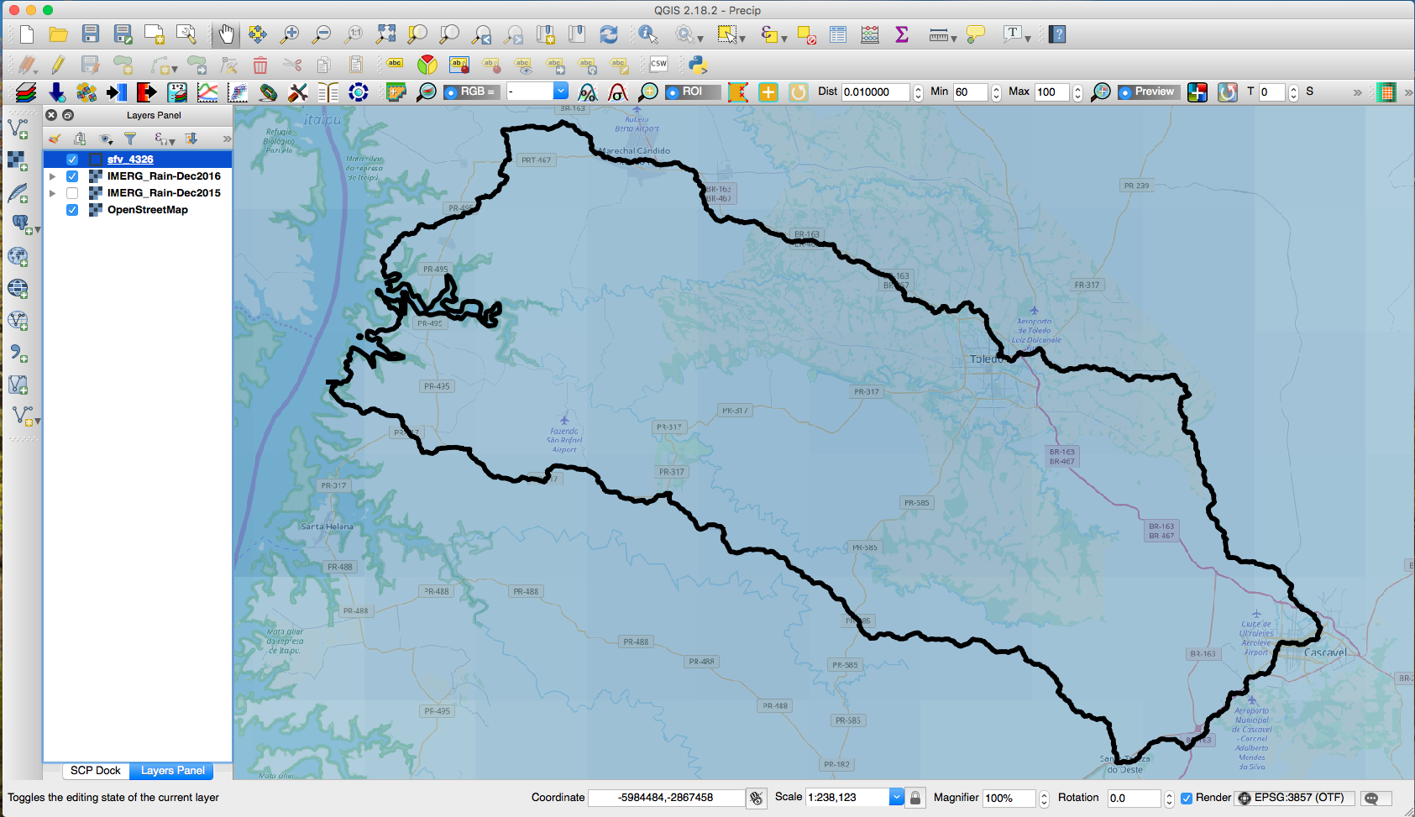
Interpolate and Clip the Precipitation Data to SFV Watershed
Click on the menu on the left bar and click on Add Vector to add the SFV shapefile sfv_4326.shp.
We’ll make the shapefile layer transparent with only the boundary outlined on the map. Right click on the layer file and go to Properties > Style
Click on the down arrow in the Fill window and select Transparent fill
Click on the down arrow in the Outline window and choose a color of the shapefile boundary (Black color is chosen in this case)
Choose outline width to be 2.0
Click OK

Slide 21
Interpolate and Clip the Precipitation Data to SFV Watershed
In the top menu, select Processing > Toolbox. A search window will appear to the right of the map. Enter interp.
You should see r.resamp.interp from the list
Double click on r.resamp.interp – this will open a window
In the Input Raster Layer window use the dropdown menu arrow to select IMERG_Rain-Dec2015 raster
In the Sampling interpolation method window, chose bilinear
In the GRASS GIS 7 region extern (xmin,xmax,ymin,ymax) window choose Layer/canvas extent from the dropdown menu
In the GRASS GIS 7 region cellsize (leave 0 for default) window enter the factor 0.01 [Note: the resolution of the IMERG data is 0.1 degree, we are interpolating to 1 km by specifying 0.01 cell size)

Slide 22
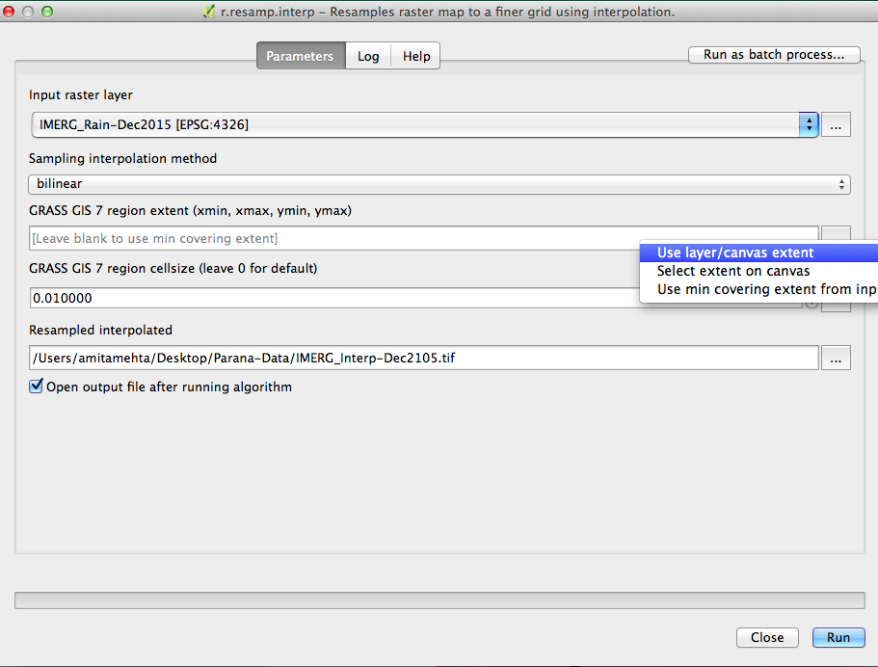
Interpolate and Clip the Precipitation Data to SFV Watershed
In the Resampled Interpolated window specify the folder and filename where the interpolated data will be saved.
Make sure that Open output file after running algorithm is selected
Click on Run at the bottom right
You will get a resampled interpolated data layer on the map (in grey colors)
By right clicking on the resampled layer > Rename layer (suggest IMERG_Interp-Dec2015)
Repeat step 4 and interpolate the 2016 rain data

Slide 23
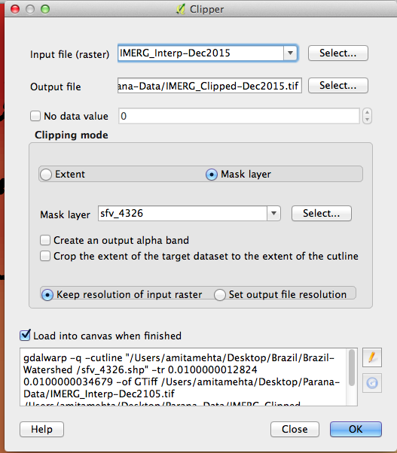
Interpolate and Clip the Precipitation Data to SFV Watershed
Now Clip the interpolated rain layers to the SFV watershed shapefile
On the top bar go to Raster > Extraction > Clipper to open the Clipper options window
In the Input File (raster) window select interpolated layer IMERG_Interp-Dec2015
In the Output file window select output folder and enter file name (suggest IMERG_Clipped-Dec2015).
Check the Mask Layer and in the Mask Layer window select the shapefile name sfv_4326.
Click OK on at the bottom right. You will see the data clipped by the shapefile boundary

Slide 24
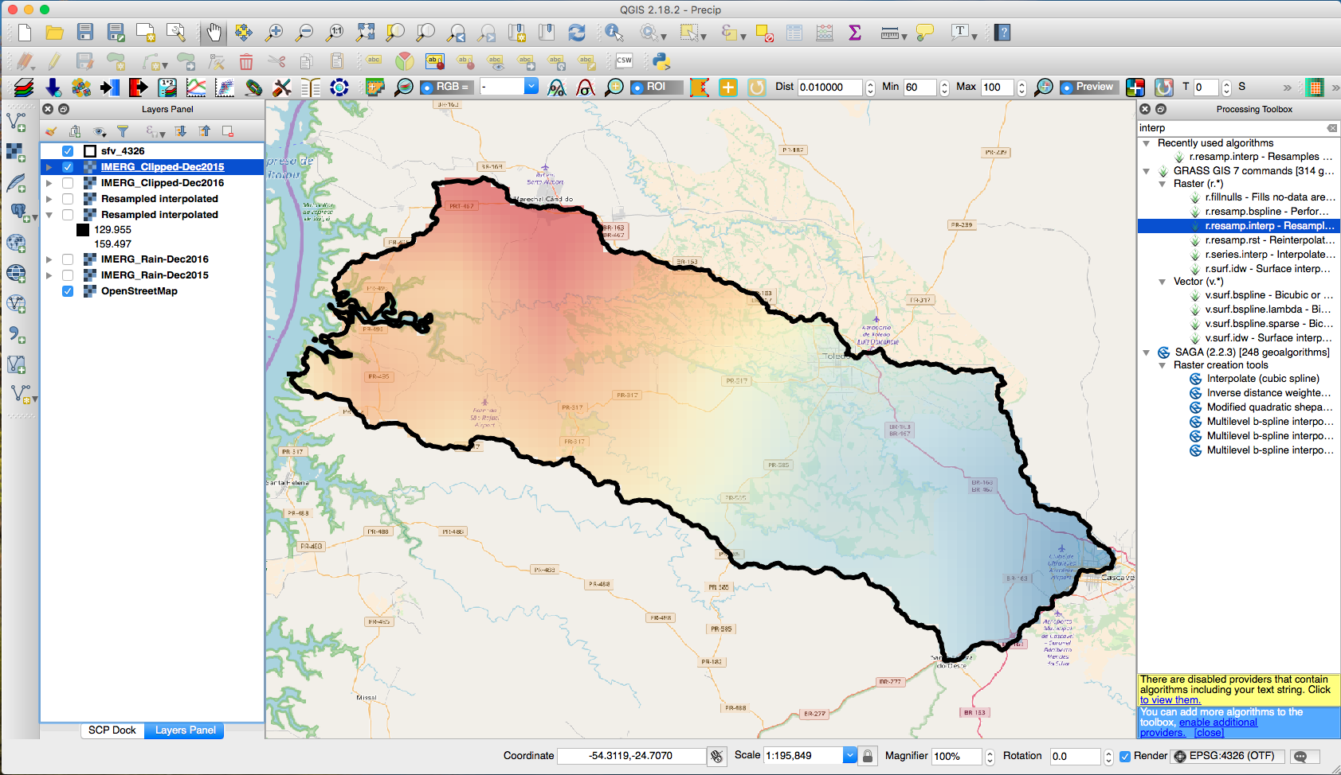
Interpolate and Clip the Precipitation Data to SFV Watershed
Repeat the above step for 2016 interpolated rain layer
Follow steps 7-9 of Convert NetCDF IMERG Data to GeeoTIFF to add colors to the clipped rain layers for 2015 and 2016. You can choose the appropriate minimum and maximum values and intervals/classes for the color table.
Note in the following example 10 classes are used. The rain range for 2015 is set to 380 to 550 mm/month while that for 2016 is set to 120 to 160 mm/month]

Slide 25
Precipitation Analysis over SFV Watershed

Slide 26
Examine Histograms for Rainfall During December 2015 & 2016
Right Click on IMERG_Clipped-Dec2015 and go to Properties > Histogram
Click Compute Histogram
You will get a histogram, minimum and maximum rain values for this layer. Note down the Min and Max values.
Repeat the steps a and b for IMERG_Clipped_Dec2016.
Compare the two histograms, looking at minimum and maximum values for the two maps

Slide 27
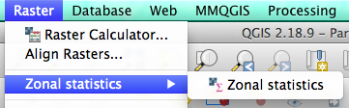
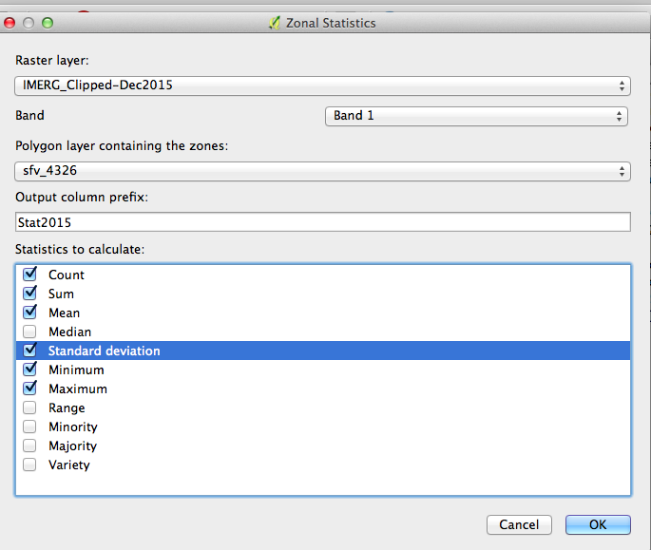
Examine Mean and Standard Deviation of Rain Data Over SFV
On the top bar select Raster > Zonal Statistics or search for Zonal Statics in the Processing Toolbox
You will get the Zonal Statistics option window
In the Raster Layer window select IMERG_Clipped-Dec2015
In the Polygon layer containing zone window make sure the sfv_4326 shapefile is selected
In the Output column prefix enter Stat2015 (or any name that you want to use to identify statistics for this layer)

Slide 28
Examine Mean and Standard Deviation of Rain Data Over SFV
In the Statistics to calculate window select Count, Sum, Mean, Standard deviation, Minimum, Maximum
Click OK on the bottom right
Repeat the above steps for IMERG_Cliped-Dec2016. Remember to change the prefix (suggest Stats2016)

Slide 29
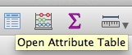
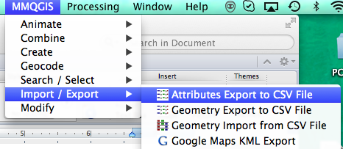
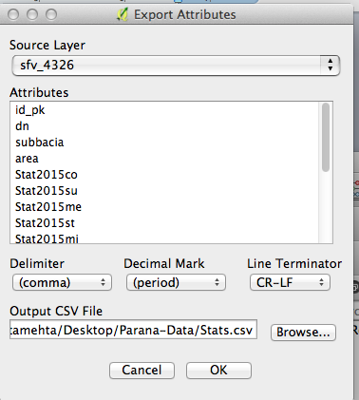
Examine Mean and Standard Deviation of Rain Data Over SFV
The statistics will be available in the Attribute Table from the top bar or right click on the shapefile under the layers panel
Click on the Attribute Table and examine the numbers.
You can copy the statistics Mean, Standard deviation, Minimum and Maximum for 2015 and 2016 layers. OR save the Attribute Table as a CSV file by using a plugin MMQGIS. If you do not have this plugin then follow the procedure you used to download and install OpenLayers plugin (Part 2, Steps 1-3), but use MMQGIS instead of OpenLayers.
Use MMQGIS > Import/Export > Attributes Export to CSV File

Slide 30
Examine Inter-Annual Difference in Precipitation
You will be calculating difference between precipitation in December 2015 and December 2016
Select Raster > Raster Calculator
From the Raster bands double click on IMERG_Clipped-Dec2015@1 layer.
The layer will appear in the Raster Calculator Expression Window
Now select minus sign (-) from the Operators
From the Raster bands double click on IMERG_Clipped-Dec2016@1 layer. The layer will appear in the Raster Calculator Expression Window

Slide 31
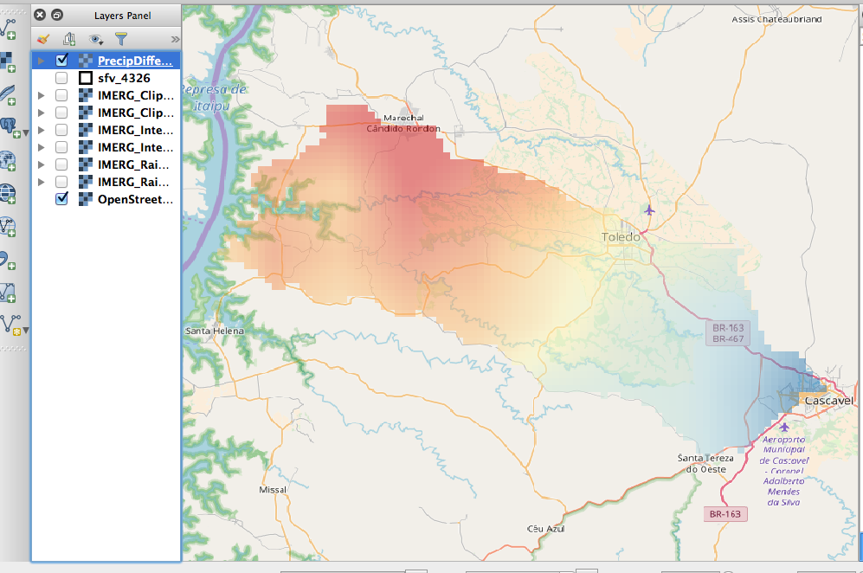
Examine Inter-Annual Difference in Precipitation
In the Raster Layer > Output Layer enter the folder/file name where the difference layer will be saved (Suggestion: PrecipDifference_Dec15&16)
Make sure that Add result to project is checked
Click OK to get the Difference map.
Make the difference layer transparent by right clicking on layer Properties > Transparency and set the level to 50% so that you can see the map. Also toggle layers on and off to see the patterns

Slide 32
Discussion Questions
Over the SFV watershed, which year had more precipitation in December?
Based on the zonal statics, what are the means and standard deviations for the two years? What were the minimum and maximum precipitation values for the two years?
Discuss the nature of the precipitation histograms in the two Decembers in terms of rainfall frequency distribution.
From the statistics and the precipitation difference, which December had less water availability? Over the SFV watershed, what was mean deficiency of precipitation (in mm/month)? Which areas of the watershed experienced large differences?

Slide 33
Discussion Questions
Based on the difference map, can you guess which areas of the SFV watershed will have larger differences in soil moisture and vegetation in subsequent months?
If you do not interpolate IMERG precipitation data would your results be different? Why?
Based on the procedure used in this exercise, can you outline the steps (including data and tools) you would take to monitor weekly precipitation availability and pattern in near real-time?

